Slide 1
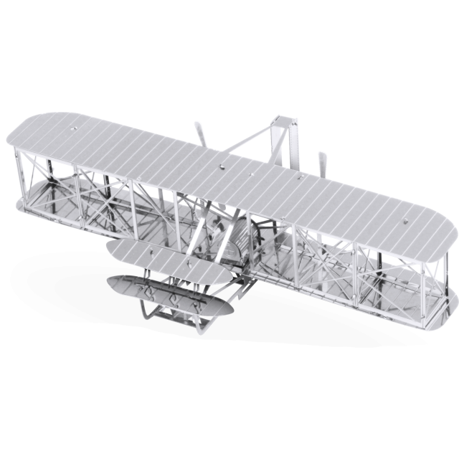

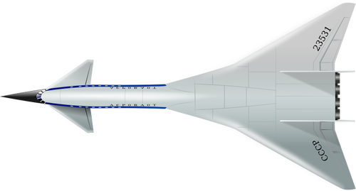
Air Transportation Network Analysis
LAKHANI, Harsh Sunil
(20910249)
LI, Ka Ho
(20922151)
TSANG, Kai Ho
(20905476)
SIMPSON, Patrick
(20820028)

Slide 2
Contents
01
04
Introduction
Network Analysis
02
05
Data
Node Classification
03
Network Visualization
06
Node Clustering

Slide 3
But First…
Notes:
Gary

Slide 4



Safety Announcement:
Please Fasten Seatbelt and Prepare for Take-off!
Emergency Exits are located at the front and rear of the lecture theatre.
Notes:
Gary

Slide 5
01
Introduction

Slide 6
About the Project
We transform air transportation data into a graph network, with airports as nodes which can retain features, and flight routes as edges.
Our aim is to:
Visualize and analyze airports and flight routes between each other.
Utilize Graph Neural Networks to perform node classification and node clustering of airports based on their features.
Generate insights to help improve operational efficiency, identify target markets for airlines, travel agencies and tourism boards.
Notes:
We will to transform air traffic datasets into graph network, with airports as nodes which can retain features, and experiment with various forms of edges.

Slide 7
Data
02

Slide 8
Data: Sources
The data used for this project is all publicly available. We obtained the flight routes, airport and runway data from separate sources:
Routes | Airports | Runways
Airline Source Airport Destination Airport Equipment Flight Route Database | Kaggle | IATA (Code) Name Type Lat, Lon Elevation Country Open data @ OurAirports | Airport ID Length Width Surface Open data @ OurAirports
Notes:
Here are some of the attributes we collected for this project

Slide 9
Data: Preprocessing
Drop any irrelevant attributes.
Reclassify Seaports and Heliports as Small Airports due to the sparsity and nature of our analysis - finally 3 sizes -> small, medium large.
Fill in missing data that could cause issues in network construction:
Missing Geodata at airport level
Transform data into multiple datasets based on specific needs of multiple tasks.
Performed exploratory data analysis to investigate and expose any erroneous data.

Slide 10
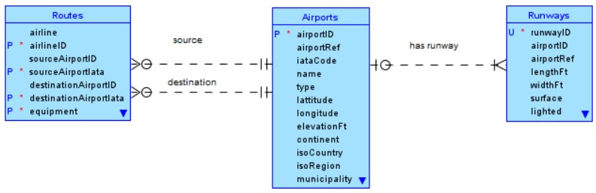
Data: Model
The ‘Routes’ table is joined with the ‘Airport’ table on both the source and destination which enables us to extract node attributes
The ‘Runways’ table is used to gain additional features including: aggregate number of runways per airport

Slide 11
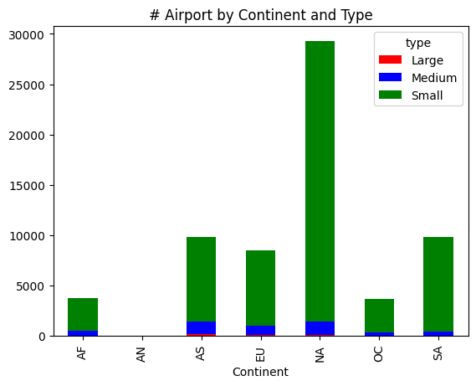
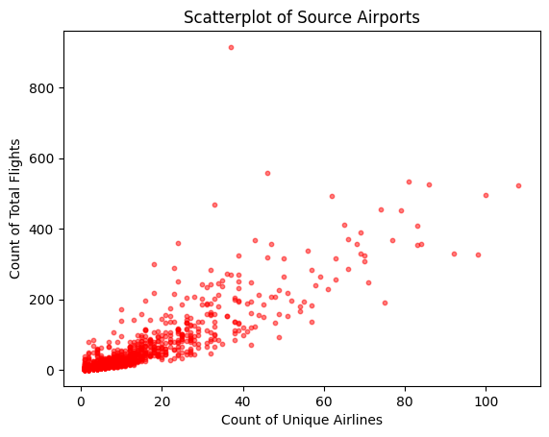
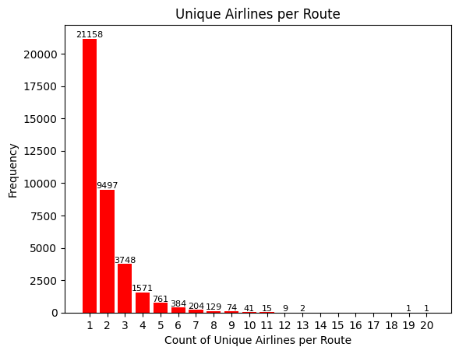
Data: Basic Properties
# Nodes: 3,425 Unique Airports
# Edges: 67,719 Routes (37,595 Unique)
Network is a homogeneous graph consisting of a single type of node: Airports
EDA:

Slide 12
Network Visualization
03

Slide 13
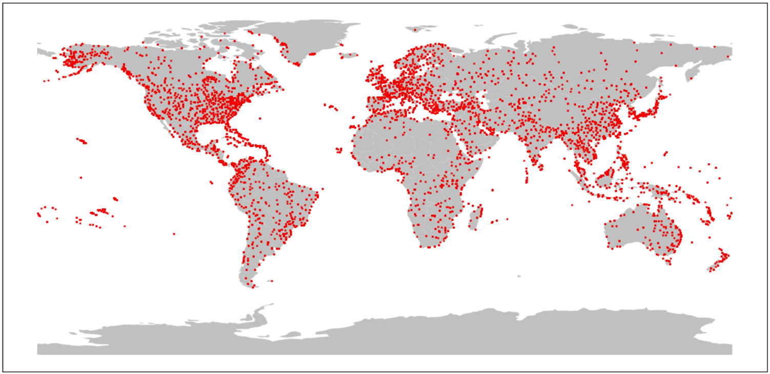
Visualization: Node (Airport) Plot

Slide 14
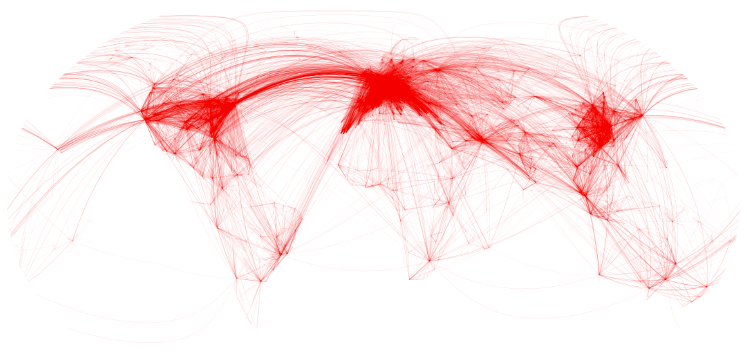
Visualization: Edges (Route) Plot

Slide 15

Visualization: Cosmograph Plot
1 giant component
Few small components
Similar to real-world expectation
3 main heat zones (North America, Europe and Asia)

Slide 16
04
Network Analysis

Slide 17
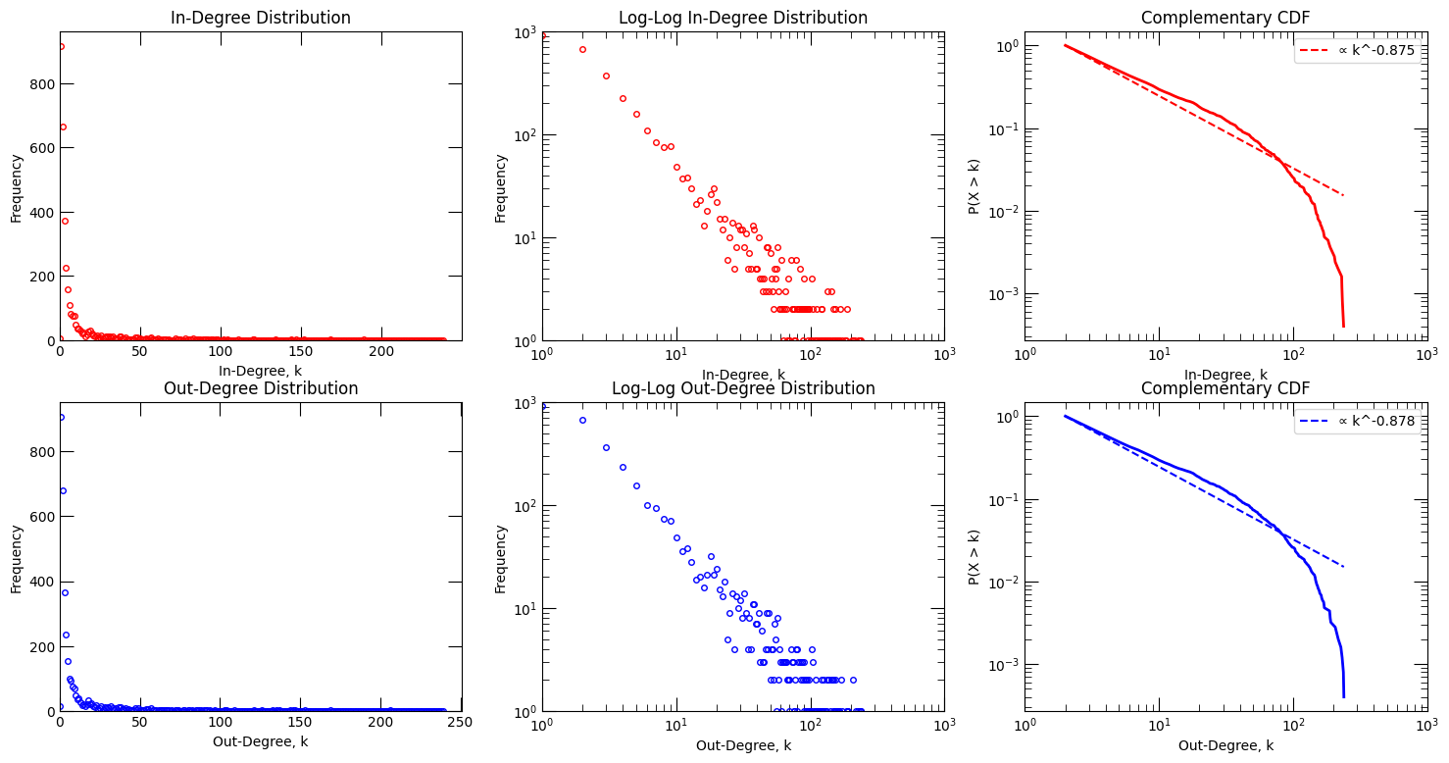
Network: Degree Distribution (Linear-Linear)
Heavy-tailed distribution

Slide 18
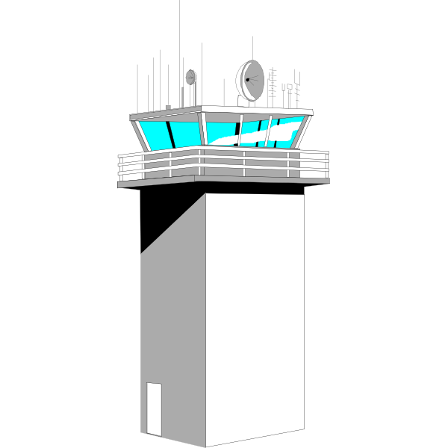
Network: Degree Distribution (Log-Log)
Power-Law

Slide 19
Network: Power-Law
Minimizing Kolmogorov-Smirnov distance
In-degree: α = 1.875
Out-degree: α = 1.878
v.s. 2 < α < 3
Slower decay rate in degree distribution
E.g. A hybrid of different types of networks
Regional hubs may have a high degree of connectivity but few connections to other nodes

Slide 20
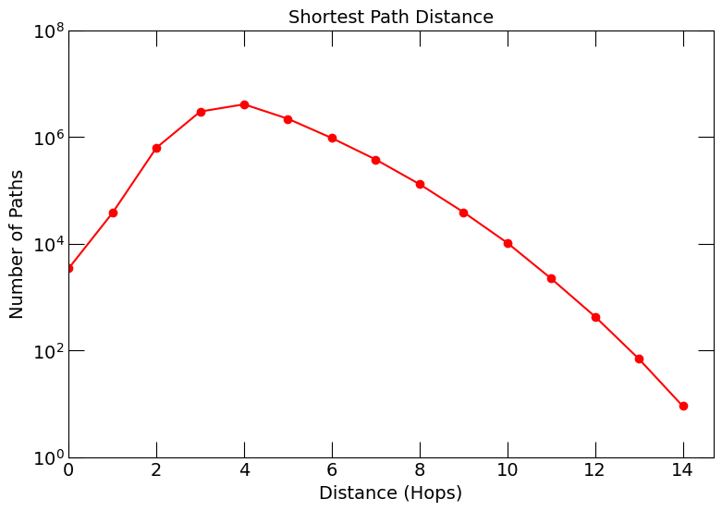
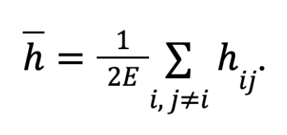
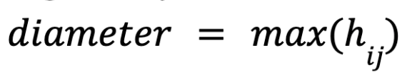
Network: Shortest Path Distance
Diameter is 14
Majority of airports can be reached within 4 hops
Mimics the concept of shortest path in a real world scenario.
Well-connected and easy to traverse

Slide 21
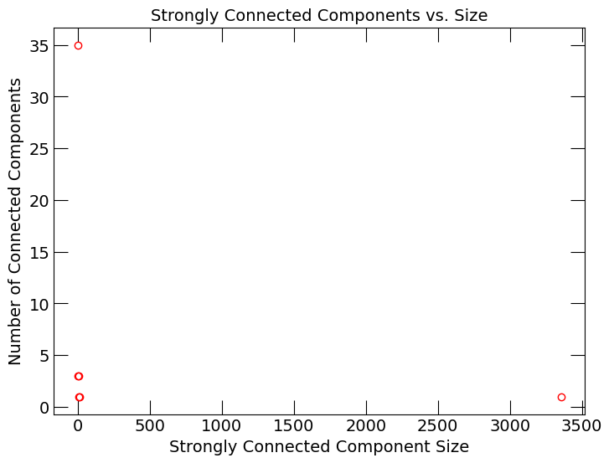
Network: Connected Components
Size | # Components
1 | 35
2 | 3
4 | 3
8 | 1
10 | 1
3354 | 1
Giant component exists!
Notes:
Patrick

Slide 22
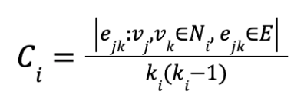
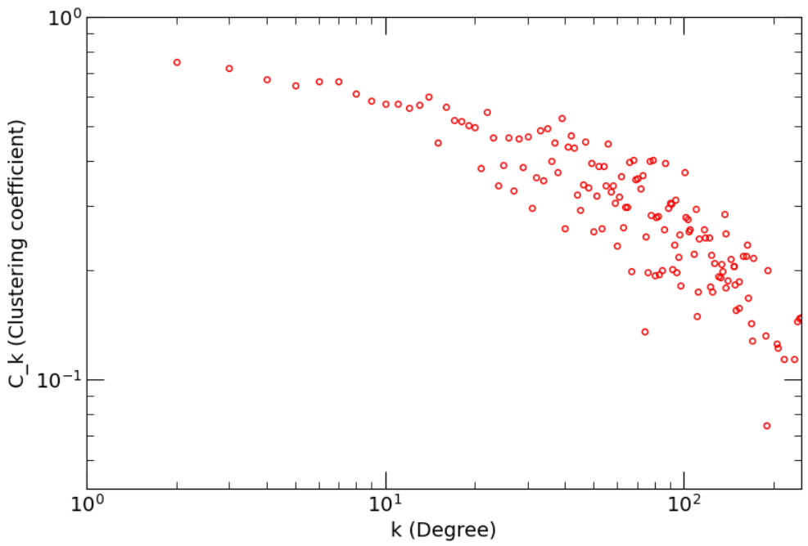
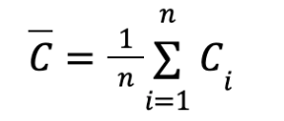
Network: Clustering Coefficient
Clustering Coefficients
Maximum number of edges for a node
Clustering coefficient of 1: 708 airports
Clustering coefficient of 0: 984 airports
→ Intermediaries for communication
Average clustering coefficient = 0.469
Real-World Network

Slide 23
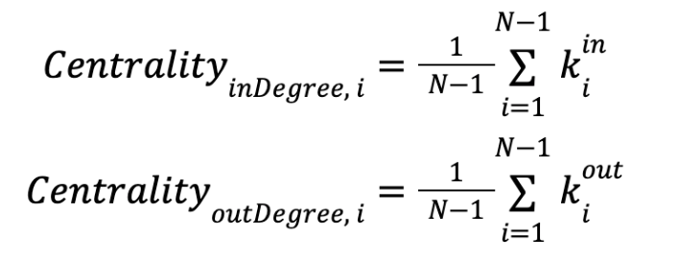
Network: Centrality - Degree
Degree centrality measures the number of connections a node has in an undirected graph
Directed graph:
Prestige of a node
Popularity of a node
High in-degree centrality: receives numerous flights
High out-degree centrality: sends numerous flights

Slide 24
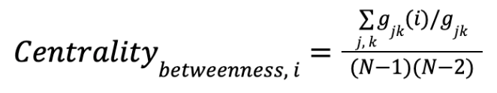
Network: Centrality - Betweenness
Betweenness centrality measures the frequency of a node lying on the shortest path between any two nodes in the graph
Directed graph: consider geodesics
Reflective of its “controlling power” of the airport over the most efficient path between any two airports
Crucial role in the efficient movement of passengers and goods

Slide 25
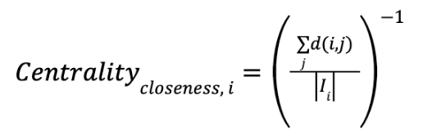
Network: Centrality - Closeness
Closeness centrality measures how easily a node can reach other nodes in the graph
Directed graph: consider nodes within the Influence range I
High closeness centrality: accessible to other airports, may not require route optimization
Strategically locate and could serve as a hub for connecting flights

Slide 26
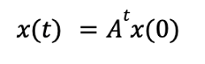
Network: Centrality - Eigenvector
Eigenvector centrality measures a node’s importance based on the centrality of its neighbours
A node’s importance increases if it has connections to other important nodes
High eigenvector centrality: help boost the economic development of less prosperous airports by forming an alliance with the influential airport

Slide 27
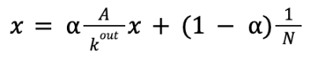
Network: Centrality - PageRank
PageRank centrality, a variant of the eigenvector centrality, quantifies the influence of a node based on its connections and contacts
More appropriate for directed graphs, especially for Directed Acyclic Graphs
Zero in-degree can have a non-zero contribution
IATA | Airport Name
LJA | Lodja Airport
IUE | Niue International Airport
STZ | Santa Terezinha Airport
SXX | São Félix do Xingu airport
PTJ | Portland Airport
VDA | Ovda Airport
MSW | Massawa International Airport
Only 7 airports that are sources, which mean zero in-degree
Negative effect of using eigenvector centrality can be neglected

Slide 28
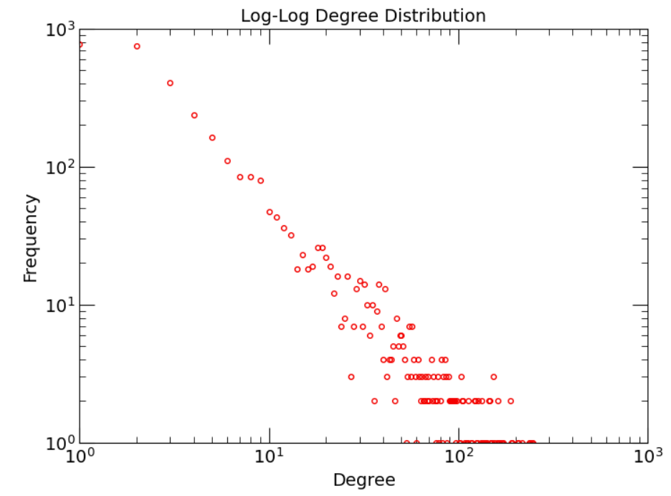
Network: Log-Log Degree Distribution
Mimics the concept of using log-log plot for degree distribution in a real world scenario
In the context of airports and flights, the power law suggests that a few major airports serve as hubs.
Small airports will see much less activity.
The power law has important implications for understanding the dynamics of domestic or global air traffic networks, and can inform decisions related to airport planning, air traffic control and airline operations.

Slide 29
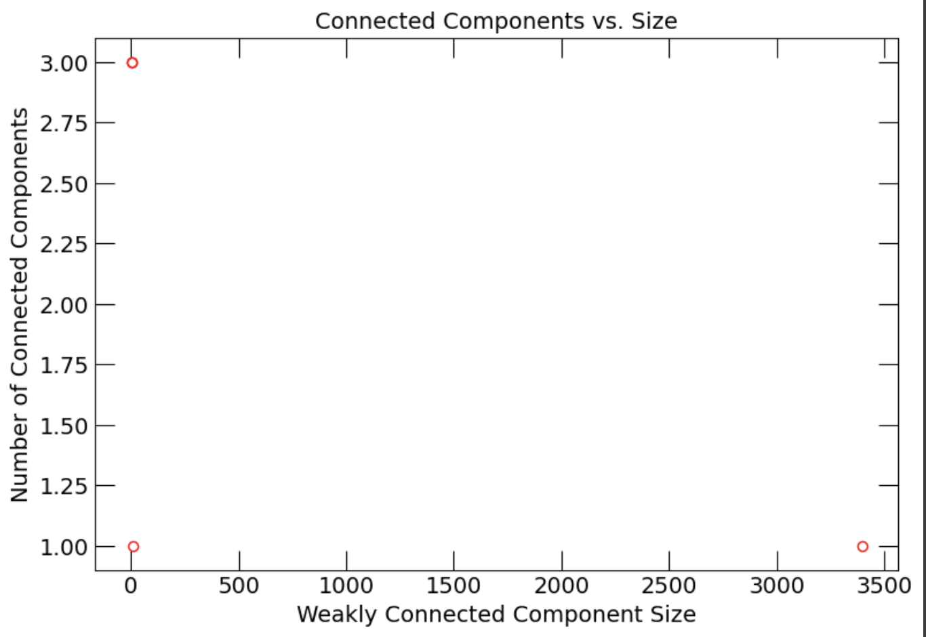
Network: Size of Connected Components
The entire network is not strongly connected
There is a clear Super Connected Component containing 99.18% of all nodes.
8 Connected Components:
Size | # Components
2 | 3
4 | 3
10 | 1
3397 | 1
Notes:
Patrick

Slide 30
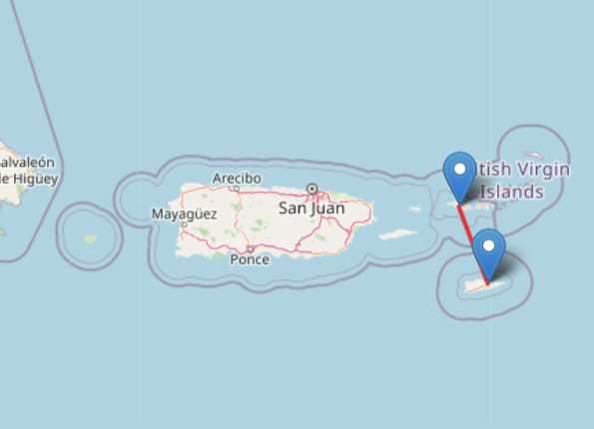
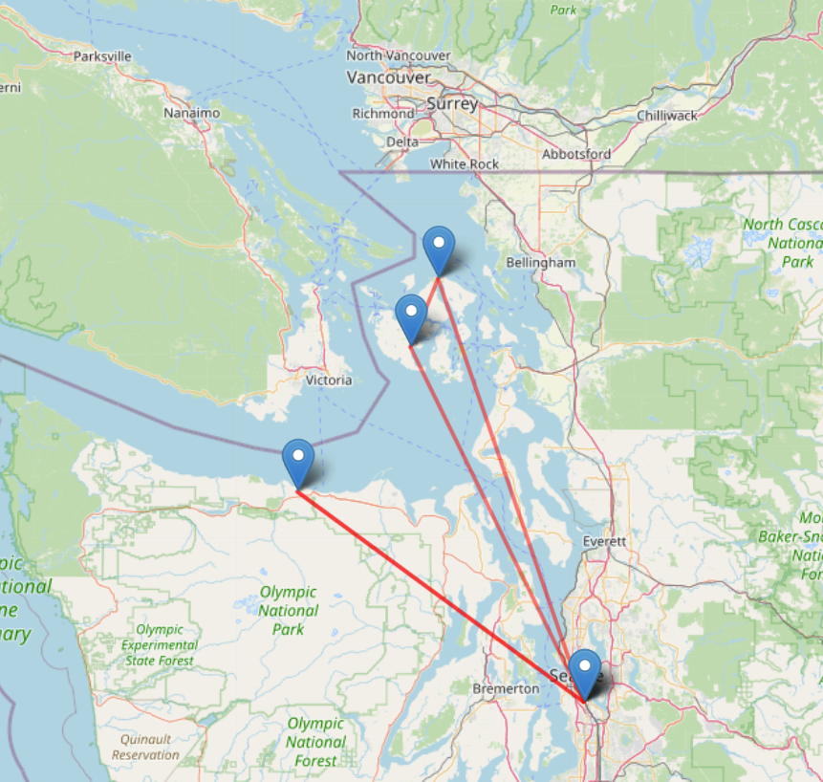
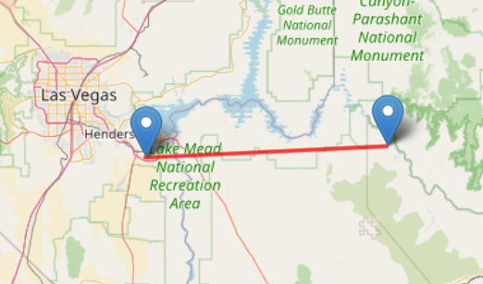
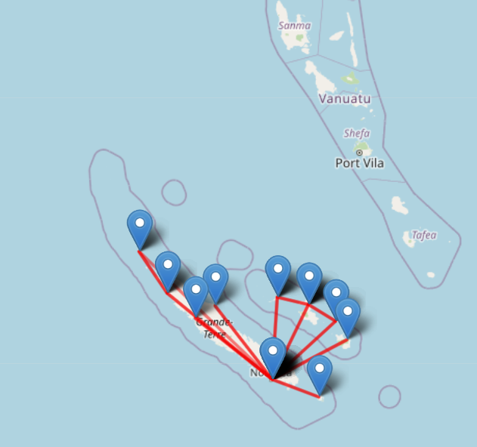
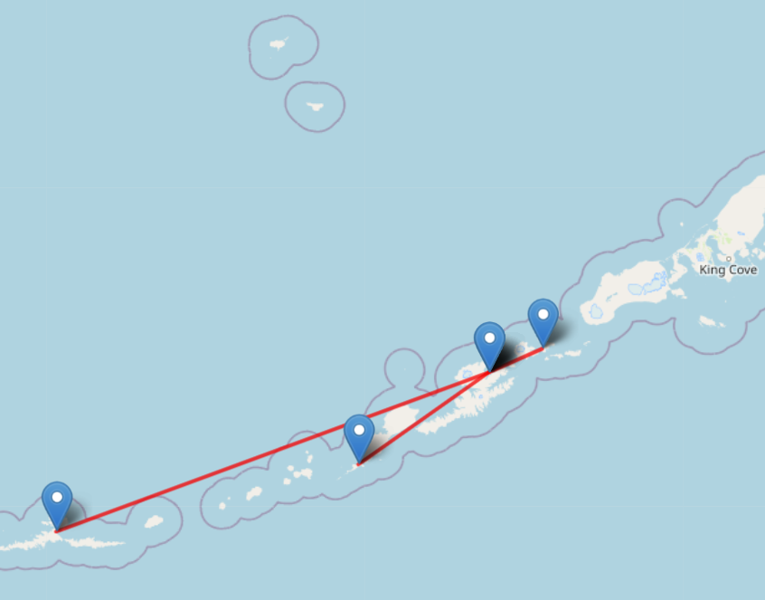
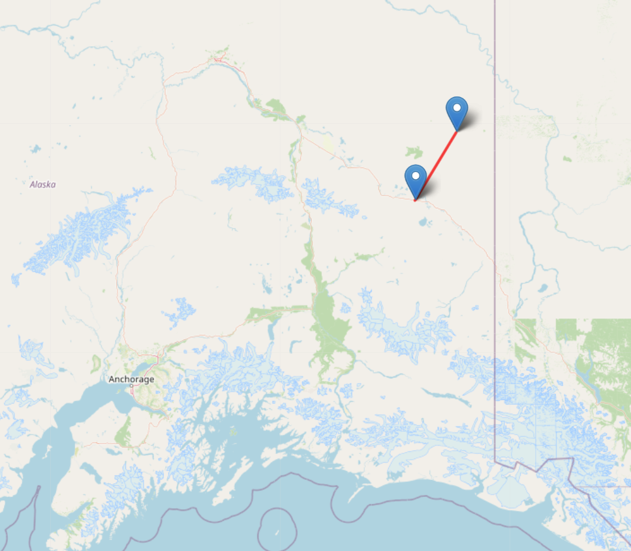
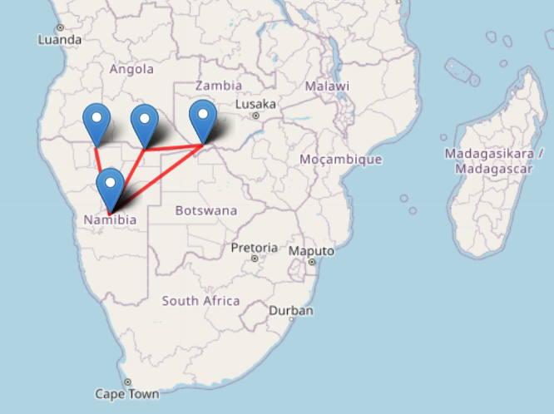
Network: Small Connected Components
From the route network, we can inspect the small connected components
In visualizing the routes in these components it is apparent that they are a mix of:
Island Hoppers | Sightseeing | Connections to / from / between Remote Locations
Caribbean:
San Juan Islands:
Las Vegas:
Pacific Islands:
Sub Saharan Africa:
Aleutian Islands:
Alaska:
Notes:
Patrick

Slide 31
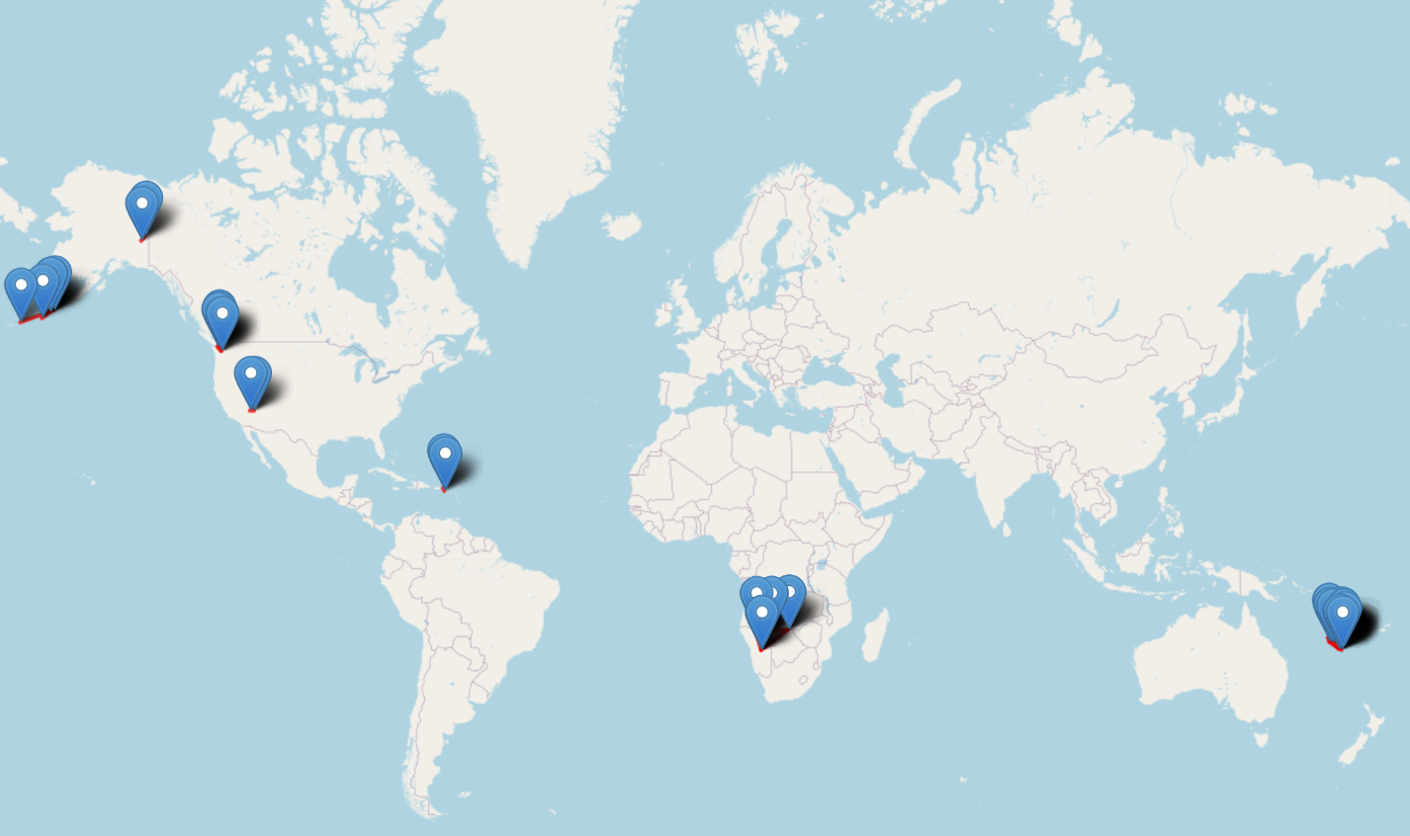
Network: Size of Connected Components
Below is the geolocation of all small connected components:
Notes:
Patrick

Slide 32
Network: Important Nodes (Hubs)
Assess the most important airports in the world as defined as ‘Hubs’
Degree Centrality, Betweenness Centrality and PageRank methods used.
The top 10 airports by ranking these metrics are all large airports.
However we also observe that these highly connected airports have different values of Centrality.
The green values show where the airports is highest in this metric, and red value shows where the airport ranks lowest (in top 10).
Airports from all regions are represented in the top 10 list.
IATA | Name | Degree Centrality | Betweenness Centrality | PageRank
CDG | Charles de Gaulle International Airport | 0.1373 | 0.0617 | 0.0039
FRA | Frankfurt Airport | 0.1393 | 0.0510 | 0.0038
IST | Istanbul Airport | 0.1335 | 0.0412 | 0.0044
ORD | Chicago O'Hare International Airport | 0.1195 | 0.0474 | 0.0043
PEK | Beijing Capital International Airport | 0.1203 | 0.0492 | 0.0038
AMS | Amsterdam Airport Schiphol | 0.1352 | 0.0427 | 0.0036
ATL | Hartsfield Jackson Atlanta International Airport | 0.1265 | 0.0294 | 0.0047
DXB | Dubai International Airport | 0.1081 | 0.0594 | 0.0036
DME | Domodedovo International Airport | 0.1104 | 0.0294 | 0.0041
LAX | Los Angeles International Airport | 0.0867 | 0.0662 | 0.0033
Notes:
Patrick

Slide 33
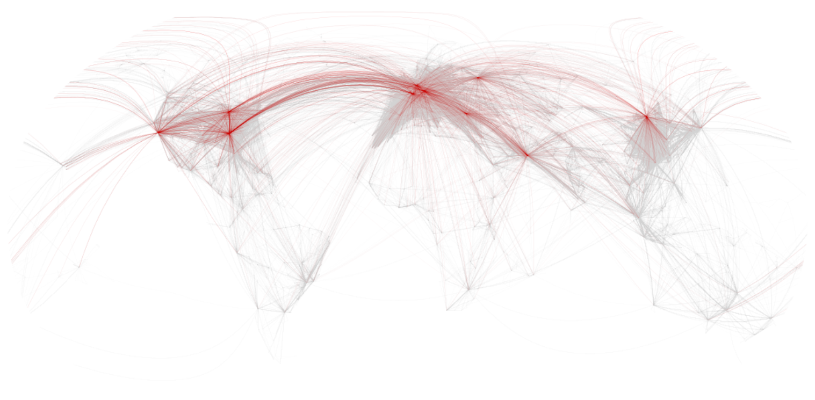
Network: Important Nodes (Hubs)
Below is the geolocation of all small connected components:
DME
AMS
FRA
ORD
CDG
IST
PEK
LAX
ATL
DXB
Notes:
Patrick

Slide 34
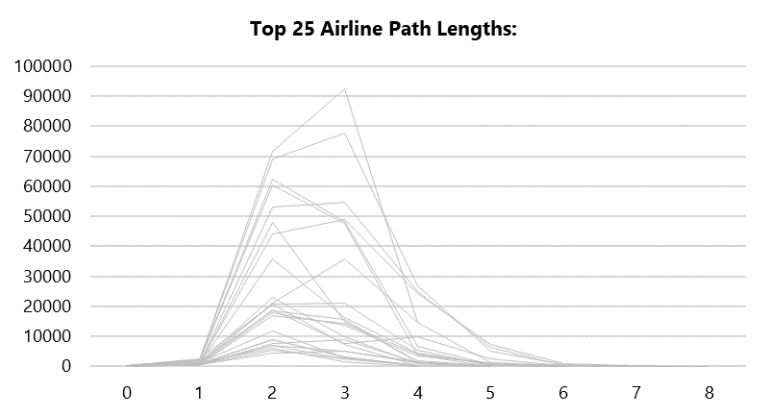
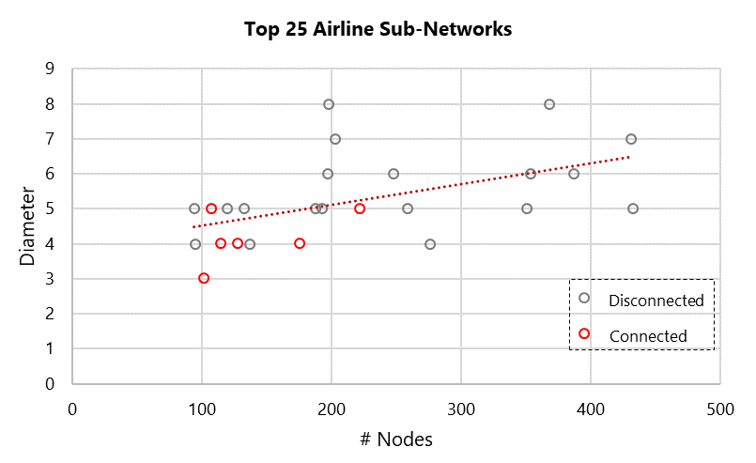
Network: Airline Reachability
From a competitive standpoint, the reachability of an airlines routes can drive a competitive advantage.
Here we take the top 25 airlines by # unique routes and assess the reachability of their network.
An airline’s network is a sub-graph of the entire network, for the routes are operated by that airline.
The shortest path and average path length is then extracted for each of these airlines.
Initial analysis shows that the largest airlines exhibit similar path lengths, typically with 2 or 3 hops being the most common shortest path within their network.
As expected, the diameter of the networks also correlates with the # nodes within the networks.
Notes:
Patrick

Slide 35
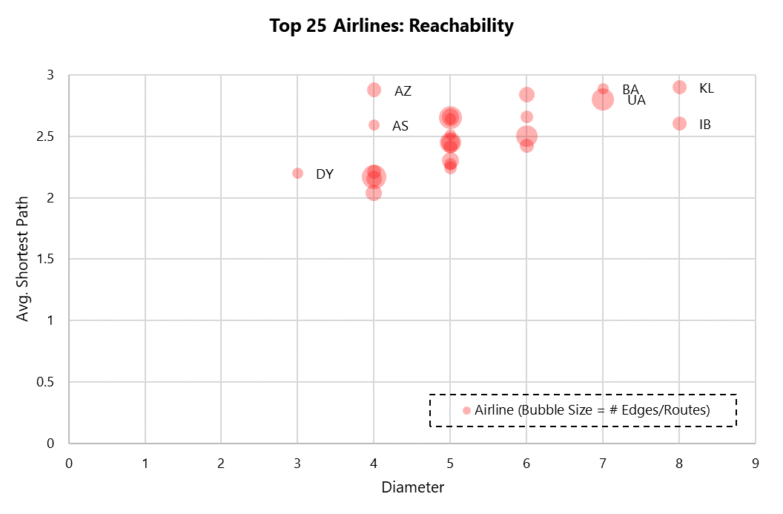
Network: Airline Reachability
In plotting the top airlines’ sub networks, we begin to see some interesting outliers:
AZ (Alitalia): Complex network?
DY (Norwegian Shuttle): Airline likely has good connectivity and operational efficiency due in part to the geographic location of its main hub and the fact that much of its network is within Norway.
UA (United) Second largest # nodes of all airliners, however the diameter and avg. shortest path. The nature of the beast here in that this airline covers so many locations domestically and internationally, although in looking at competition with a similar number of airports - AA (American), we see that American are able to command a -5% smaller avg. shortest path and -28% smaller network diameter. Both have their hubs located in Texas although different airports.
IB (Iberia) has a low avg, shortest path length relative to it’s high network’s diameter and # nodes. Spanish airline which serves many far flung islands.
high avg. shortest path
high # nodes
low avg. shortest path, high diameter
v
low diameter
Notes:
Patrick

Slide 36
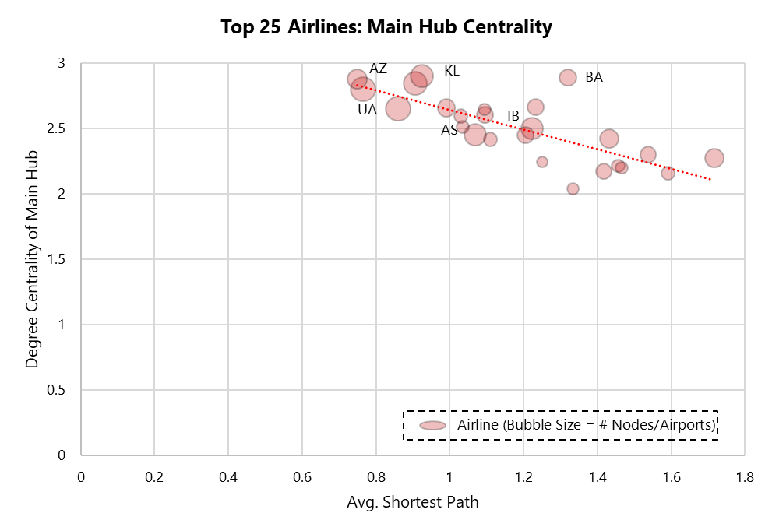
Network: Airline Reachability
Further analysis into these outliers, versus the top 25 peer average.
Using degree centrality to discern the hub for each carrier, then assessing the significance of its centrality.
There is an observable pattern with avg. shortest path and the centrality of the airline's hub (table).
Plotting the top 25 airlines shows a correlation between the degree centrality of the hub and the avg. shortest path (chart).
Therefore airlines that may look to reduce operational complexity can look to reduce flights outside of their hub, route existing flights through their hub or generate more flights via their hub.
Here the evidence supports intrinsic logic around operations airline planning.
Airline | SCC % of Total Sub Graph | # Nodes | # Edges | Avg. Shortest Path | Diameter | Main Hub | Main Hub Degree Centrality
UA | 97.9% | 431 | 2179 | 2.80 | 7 | IAH | 0.76
AZ | 95.7% | 276 | 877 | 2.88 | 4 | FCO | 0.75
IB | 95.5% | 198 | 831 | 2.60 | 8 | BCN | 1.10
DY | 100.0% | 102 | 576 | 2.20 | 3 | OSL | 1.47
Top 25 Avg. | 97.8% | 220.6 | 1128 | 2.50 | 5.2 |  | 1.19
Notes:
Patrick

Slide 37
05
Node Classification
Notes:
Gary

Slide 38
Node Classification
Why is it Important?
Benchmarking & Analysis | Comparing the operational efficiency and profitability of airports can help: → Identify areas for improvement and inspiration → Best practices and policies that can be shared across the industry
Optimization & Marketing | Help airlines, travel agencies, and tourism boards target specific markets: → Airlines may select larger airports that are better equipped to handle larger aircraft and more passengers → Travel agencies may promote smaller airports as a more convenient and hassle-free alternative to larger airports
Notes:
Gary

Slide 39
Node Classification
Classify the size of an airport with regard to Centrality:
Large, Medium, or Small
Features:
In-degree Centrality
Out-degree Centrality
Betweenness Centrality
Closeness Centrality
Eigenvector Centrality
Notes:
Gary

Slide 40
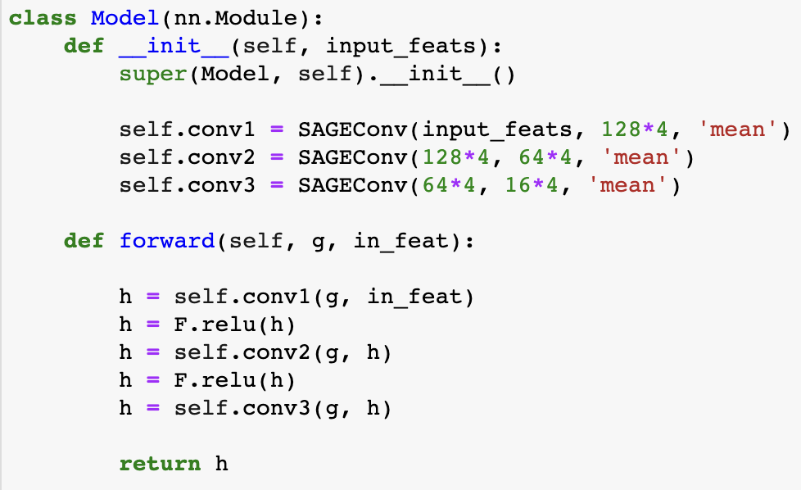
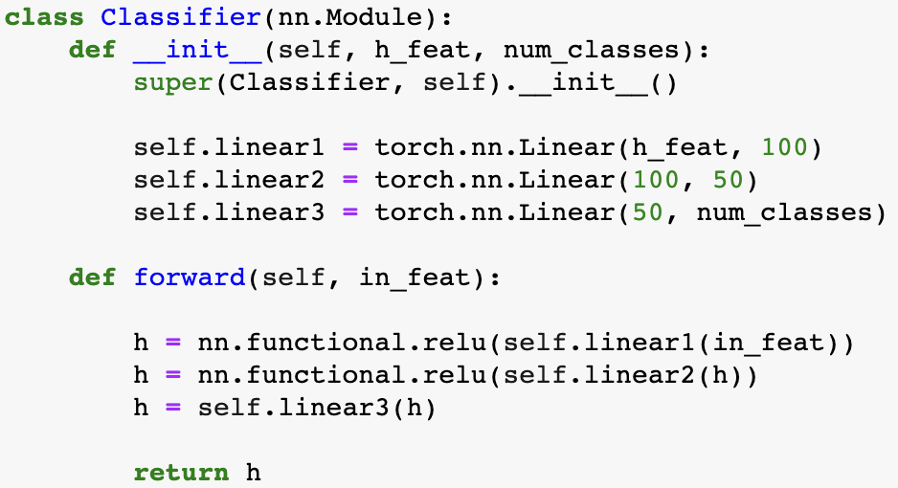
Node Classification
SAGEConv | Classifier
Notes:
Gary

Slide 41
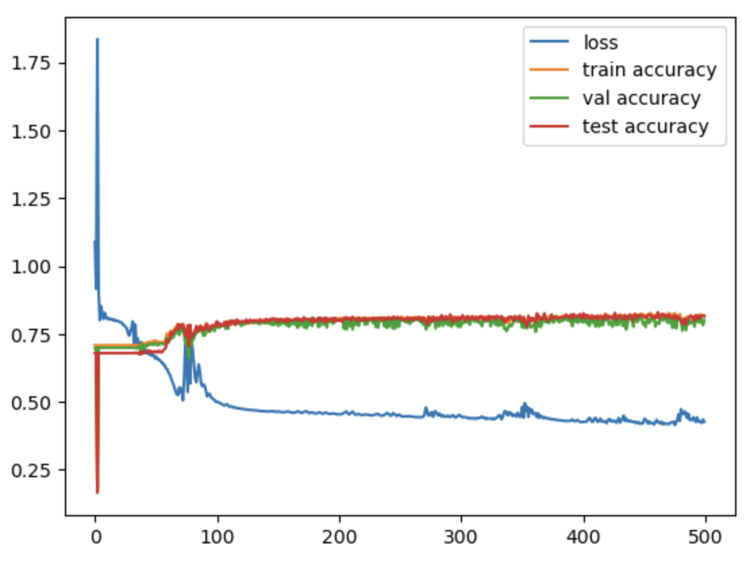
Node Classification
Optimizer | Adam
Learning Rate | 0.01
Loss Function | Cross Entropy Loss
Epochs | 500
Reached the optimal at around 100 epochs
Best validation and testing accuracy are 0.830 and 0.808 respectively
Notes:
Gary

Slide 42
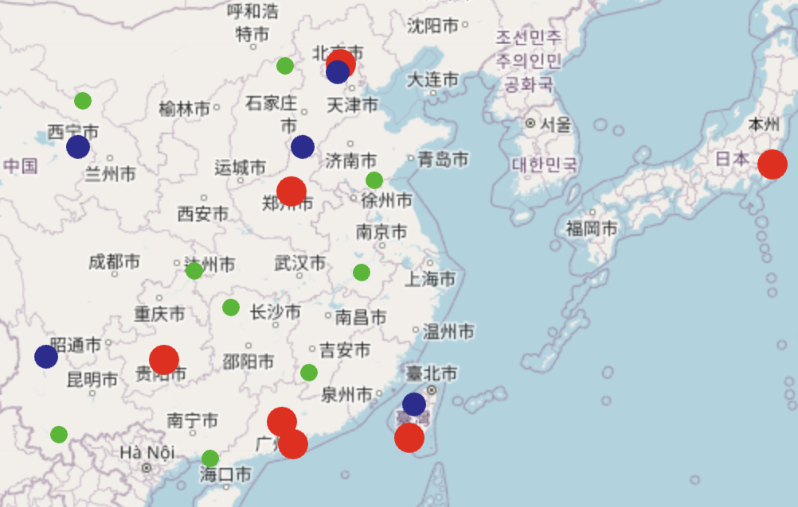
Node Classification
Red: Large Airport
Blue: Medium Airport
Green: Small Airport
Notes:
Gary

Slide 43
Node Clustering
06
Notes:
Aaron

Slide 44
Node Clustering
Cluster airports based on their route patterns in the network:
Weighted, non-symmetric adjacency matrix
Route Recommendation and Optimization | Comparing and analyzing various network features including clustering coefficient and various centrality measures: → Identify special clusters E.g. low degree centrality but high betweenness centrality → underserved but high-demand with high visitor traffic → Enhance operational efficiency for airlines, airports, and passengers
Notes:
Gary

Slide 45
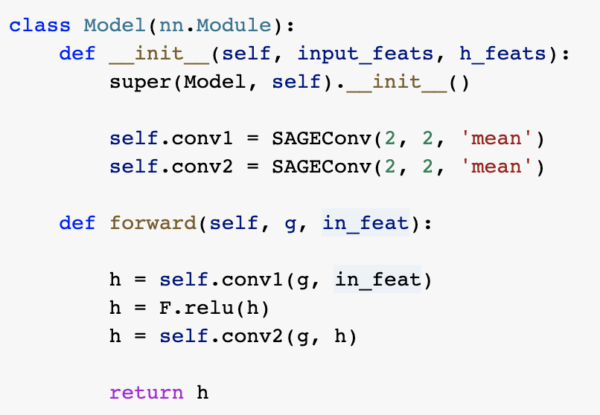
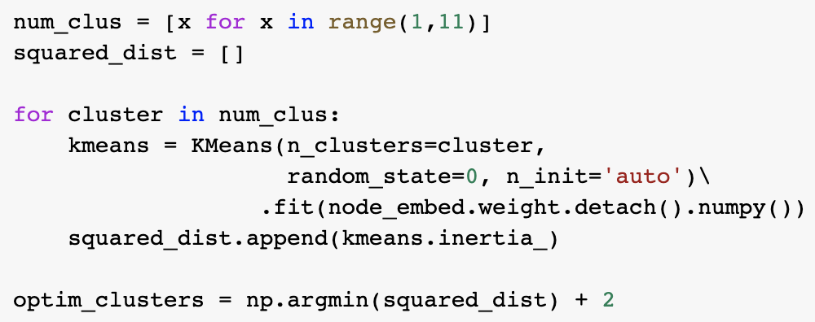
Node Clustering
SAGEConv | KMeans
Notes:
Gary

Slide 46
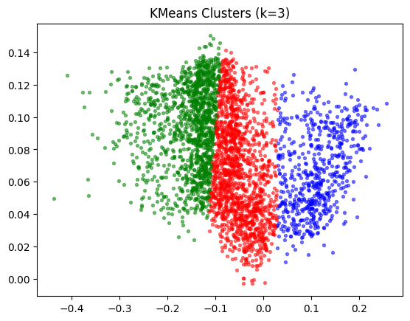
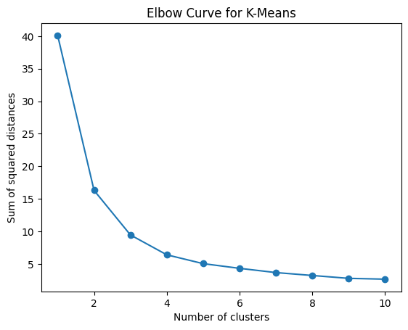
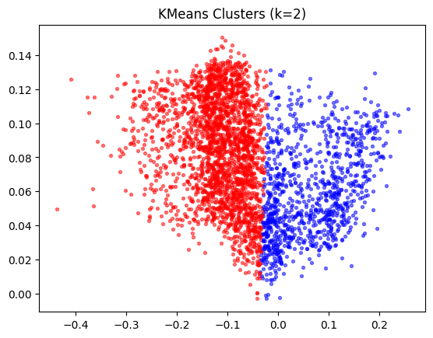
Node Clustering
Optimal number of clusters is either 2 or 3
Notes:
Gary

Slide 47
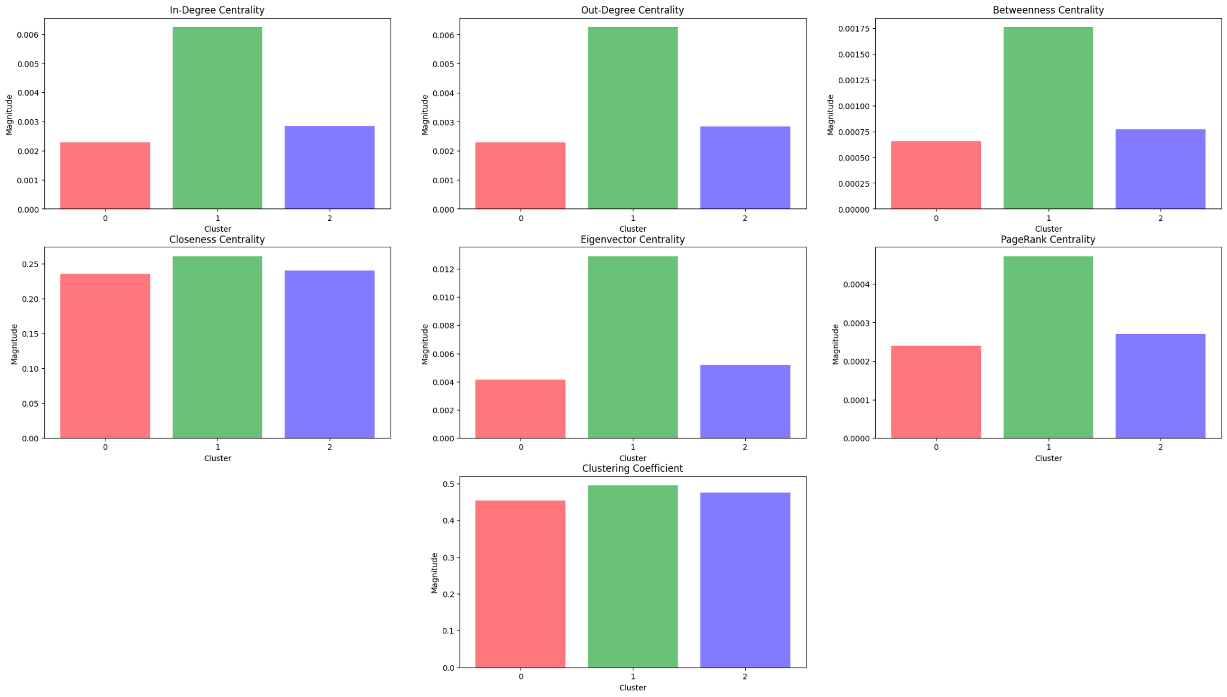
Node Clustering
Cluster 1 dominates
Clusters 0 & 2 are similar
→ Optimal number of clusters = 2
Notes:
Gary

Slide 48
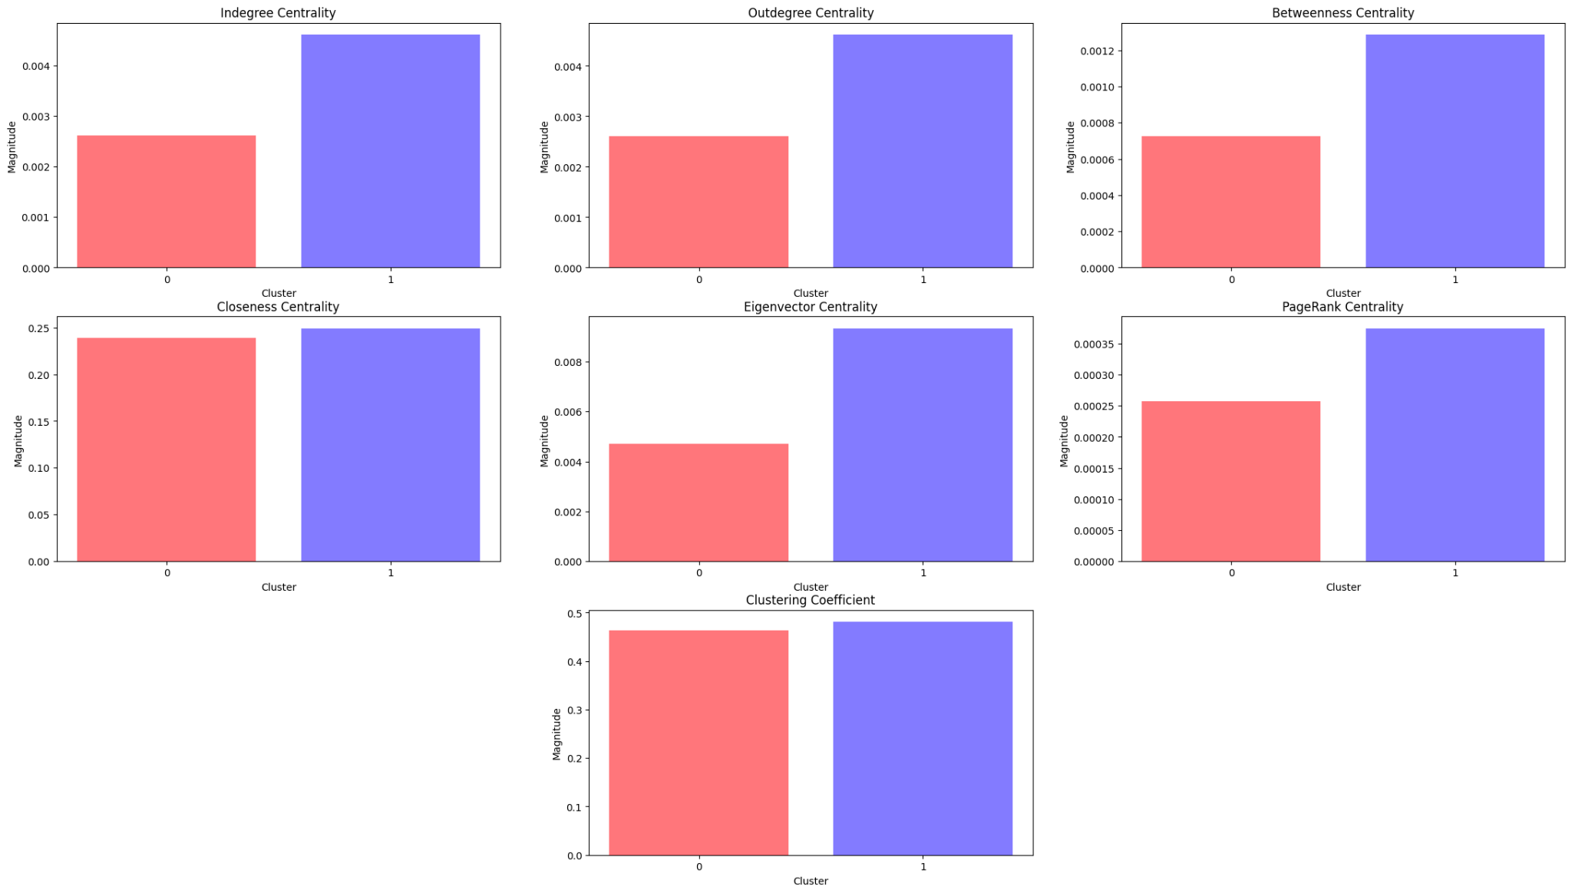
Node Clustering
Cluster 1 dominates
Clustering coefficient & Closeness centrality are consistently high
→ Strong connectivity patterns &
interconnectedness among neighbours
→ Route optimization not recommended
Notes:
Gary

Slide 49
Conclusion
Utilized GNNs to embed features
Performed Node Classification and Clustering
In-depth analysis of network to generate important insights
Achieved our purpose:
Improved decision-making for airlines, airports and passengers
Identify target markets for airlines, travel agencies and tourism boards
Improved Route Optimization and Operational Efficiency
Notes:
Harsh

Slide 50
Future Work
Link Prediction
Predict routes for proposed airports
Temporal Analysis
Analyze evolution of network over time
Recognize trends
Multimodal Transportation Network
Expand analysis encompassing other modes of transportation
Node Feature Engineering
Explore additional node features:
Passenger traffic, airport facilities or socio-economic factors
Alternative Clustering Techniques
Experiment with different clustering algorithms and model architectures

Slide 51


Thank You!
Notes:
All

Slide 52
Q&A
Notes:
All

